Slide 1
CI/CD Workshop

Slide 2
Agenda
Historical Background
Which Problem does it solve
Continus Delivery
Different usages and types
Alternatives
Best practices
Our Pipeline
  How does our pipeline work
  Demo
Assignment

Slide 3
History of CI/CD
CI/CD = Continuous Integration & Continuous Delivery/Deployment
Originated in the late 1990s, became mainstream in the early 2010s
Goal: Automate build, test, and deployment processes
Today: Integrated into platforms like GitHub and GitLab
Notes:
https://medium.com/@DiggerHQ/a-brief-history-of-ci-cd-tooling-5a67c2638f3a

Slide 4
How software used to be built
Developers built and tested software manually on their own computers
Every environment was different ➔ different libraries, setups, dependencies
Integrating code from several developers often caused conflicts and failure
Releases were rare, risky and stressful events
Problems:
  Inconsistent environments ➔ unstable builds
  Large releases ➔ many bugs
Notes:
https://medium.com/@DiggerHQ/a-brief-history-of-ci-cd-tooling-5a67c2638f3a

Slide 5
1st Generation: Beginning of automation
Growing teams needed a shared build enviroment
Hostet on physical server
Manual setup and maintenance
First time builds were centralized, not done manually
Examples
  CruiseControl (2001) ➔ frist popular CI tool
  Hudon (2005) ➔ renamed Jenkins (2011) after Oracle dispute
  Team City (2006) from JetBrains
Notes:
https://medium.com/@DiggerHQ/a-brief-history-of-ci-cd-tooling-5a67c2638f3a

Slide 6
2nd Generation: From server to the cloud
Cloud Adaption in the 2010s ➔ CI moved online (CI-as-a-Service)
Benefits:
  No server to maintain
  Easy integration with cloud and GitHub
  CI becames accessible to everyone, not just large companies
Examples
  Travis CI (2011) – first GitHub-integrated CI
  CircleCI (2011) – faster, introduced Docker support
Notes:
https://medium.com/@DiggerHQ/a-brief-history-of-ci-cd-tooling-5a67c2638f3a

Slide 7
3rd Generation: CI/CD becomes part of code platform
Integrated with Git Hosting
No need for external CI tools
Reusable workflows and community-driven ecosystem
CI/CD is standard for modern software teams
Examples
  GitLab CI/CD (2015) – first fully integrated CI/CD in Git hosting
  GitHub Action (2018) – built-in automation + reusable “Actions”
Notes:
https://medium.com/@DiggerHQ/a-brief-history-of-ci-cd-tooling-5a67c2638f3a

Slide 8
Relevancy
Dev-Op Activities are becoming more popular
CI / CD automation is one of the most common Dev Op activity
Automation of Testing and Deployment
Notes:
A recent study shows that 83% percent of developers are participating in Dev Op activities regularly
https://cd.foundation/state-of-cicd-2024/

Slide 9
Which Problem does it solve
Process Step | Without CI/CD | With CI/CD
New Feature Completed | Manual, often incomplete testing | Automated testing runs immediately after each commit
Error Detection | Detected late — during manual testing or even in production | Detected early through automated checks and unit tests
Test Environment Setup | Manual, inconsistent, error-prone | Automated and consistent across all environments
Go-Live / Deployment | Manual deployment, often done at night or weekends to avoid downtime | Automated, scheduled deployments with rollback options
Team Workload | High manual effort, stressful release days | Streamlined workflow, faster feedback, and fewer errors
Notes:
https://www.dataspark.de/blog/neues-von-dataspark-in-unserem-blog-1/ci-cd-verstehen-der-schlussel-zu-schnelleren-sicheren-software-releases-31

Slide 10

1. Principle of the Agile Manifesto
Our highest priority is to satisfy the customer
through early and continuous delivery
of valuable software.
Notes:
https://agilemanifesto.org/iso/de/manifesto.html

Slide 11
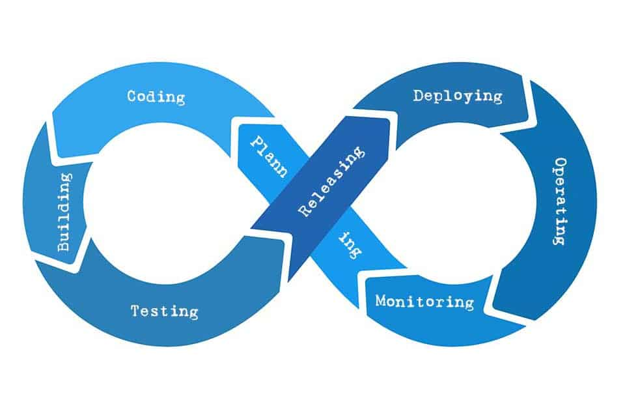
🔁 Agile = Philosophy of continuous improvement
⚙️ Continuous Delivery = Technical implementation of this philosophy
After each sprint: a production-ready version
Notes:
https://t2informatik.de/wissen-kompakt/continuous-delivery/#:~:text=Continuous%20Delivery%20%E2%80%93%20die%20Perfektionierung%20der,ein%20Fundament%20f%C3%BCr%20Continuous%20Delivery.

Slide 12
Different Usages and Types
Different usages of a CI CD pipeline include
  Automatic building, testing and deployment of applications
  //TODO

Slide 13
Alternatives
Classic “old school” way
CI (without CD)
GitOps
  Using Git repositories as the single source of truth.
  implement infrastructure automation
Daily / Nightly Builds
Notes:
GitOps utilizes practices from CI/CD, where Git is not only for code, but also for managing infrastructure and deployments.
The idea: Everything — also configurations files — are stored as code in Git.
This makes Git the single source of truth, meaning: what’s in Git is exactly what should be running in the system.
Automation tools (like ArgoCD or Flux) automatically read the Git repository and make sure the real infrastructure matches it.
So instead of pushing changes from the CI/CD pipeline, GitOps pulls changes automatically — this is called the pull model.
Benefits:
Easier rollbacks (just revert a Git commit)
Consistent environments (no manual configuration)
https://about.gitlab.com/topics/gitops/ (partly not everything)

Slide 14
Best practices – CI
Frequent commits
Embrace Continuous Integration
Write Comprehensive Tests
Fast feedback
Notes:
1. Frequent commits
This allows for easier identification and resolution of conflicts, reducing the risk of code integration issues.
3. Embrace Continuous Integration
Integrate code changes frequently to detect bugs and conflicts early on. ➔ Therefore, our CI, runs at every commit in every branch
4. Write Comprehensive Tests
Create a robust suite of unit, integration, and end-to-end tests to ensure the quality of your code. Automated testing frameworks like JUnit or Selenium can help streamline this process. ➔ Otherwiese the CI losses is sense
4. Fast Feedback
On default, when using GitHub Actions
https://zeet.co/blog/cicd-pipeline-best-practices

Slide 15
Best practices – CD
Infrastrucutre as Code (IaC)
Blue/Green Deployments
Canaray Releases
Notes:
Infrastructre as Code (IaC)
Use IaC tools like Terraform or CloudFormation to define and manage the infrastructure required for deployment. ➔ GitOps
3. Blue/Green Deployments
Implement blue/green deployments, where a new version of the software is deployed to a separate environment before switching traffic to it. This allows for seamless rollbacks in case of issues and minimizes downtime for end users.
4. Canary Releases
Gradually roll out new features or changes to a subset of users or servers to monitor their impact before full deployment. This minimizes the risk of widespread issues and allows for fine-tuning before reaching a wider audience.
https://zeet.co/blog/cicd-pipeline-best-practices#continuous-integration-ci-best-practices

Slide 16
Best practices – Feedback loop
Key Performance Indicators
Automated Monitoring
Retrospectives and Continuous Improvement
Notes:
Key Performance Indicators
Define and track KPIs related to build times, test coverage, deployment frequency, and overall pipeline efficiency.
Automated Monitoring
Implement automated monitoring tools to track the performance and health of the CI/CD pipeline, including build failures, test coverage, deployment success rates, and system resource utilization. This allows for proactive identification and resolution of issues.
Retrospective and Continus Improvement
Can be mentioned in our retrospective meeting ➔ to gather feedback from the development team and identify areas for improvement in the CI/CD pipeline.
https://zeet.co/blog/cicd-pipeline-best-practices#continuous-integration-ci-best-practices

